Slide 1
W4111 – Introduction to Databases Section 002, Spring 2024 Lecture 9 Module II (3), NoSQL (3)
© Donald F. Ferguson, 2024

Slide 2
W4111 – Introduction to Databases Section 002, Spring 2024 Lecture 10 Module II (3), NoSQL (3)
Say something if you are in OHs and I an not paying attention.
We will start in a couple of minutes.
© Donald F. Ferguson, 2024

Slide 3

Module II, Part 3
3 | COMS W4111_002_2024_1 - Lecture 10: Module II (3), NoSQL (3) © Donald F. Ferguson, 2024

Slide 4

Reminder
4 | COMS W4111_002_2023_3: Lecture 9: Module II, NoSQL 2 © Donald F. Ferguson, 2023

Slide 5
Query Processing
5 | COMS W4111_002_2023_3: Lecture_11_Module_II_NoSQL_4 © Donald F. Ferguson, 2023

Slide 6

Transactions
Find things quickly.
Load/Save quickly.
Transactions
Durability
Database Systems: The Complete Book (2nd Edition) by Hector Garcia-Molina (Author), Jeffrey D. Ullman (Author), Jennifer Widom (Author)

Slide 7
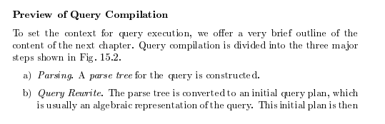
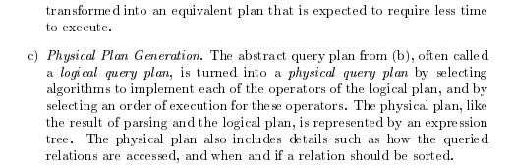
Query Compilation
Database Systems: The Complete Book (2nd Edition) 2nd Edition
by Hector Garcia-Molina (Author), Jeffrey D. Ullman (Author), Jennifer Widom (Author)

Slide 8
Parsing and Execution
Parser/Translator
Verifies syntax correctness and generates a parse tree.
Converts to logical plan tree that defines how to execute the query.
Tree nodes are operator(tables, parameters)
Edges are the flow of data “up the tree” from node to node.
Optimizer
Modifies the logical plan to define an improved execution.
Query rewrite/transformation.
Determines how to choose among multiple implementations of operators.
Engine
Executes the plan
May modify the plan to optimize execution, e.g. using indexes.

Slide 9
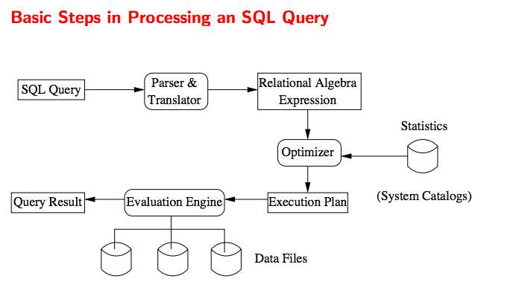
Query Processing Overview

Slide 10
Chapter 15: Query Processing

Slide 11
Chapter 15: Query Processing
Overview
Measures of Query Cost
Selection Operation
Sorting
Join Operation
Other Operations
Evaluation of Expressions

Slide 12
Basic Steps in Query Processing
1. Parsing and translation
2. Optimization
3. Evaluation

Slide 13
Basic Steps in Query Processing (Cont.)
Parsing and translation
translate the query into its internal form. This is then translated into relational algebra.
Parser checks syntax, verifies relations
Evaluation
The query-execution engine takes a query-evaluation plan, executes that plan, and returns the answers to the query.

Slide 14
Basic Steps in Query Processing: Optimization
A relational algebra expression may have many equivalent expressions
E.g., σ_{salary<75000}(∏_{salary}(instructor)) is equivalent to ∏_{salary}(σ_{salary<75000}(instructor))
Each relational algebra operation can be evaluated using one of several different algorithms
Correspondingly, a relational-algebra expression can be evaluated in many ways.
Annotated expression specifying detailed evaluation strategy is called an evaluation-plan. E.g.,:
Use an index on salary to find instructors with salary < 75000,
Or perform complete relation scan and discard instructors with salary ≥ 75000

Slide 15
Basic Steps: Optimization (Cont.)
Query Optimization: Amongst all equivalent evaluation plans choose the one with lowest cost.
Cost is estimated using statistical information from the database catalog
e.g.. number of tuples in each relation, size of tuples, etc.
In this chapter we study
How to measure query costs
Algorithms for evaluating relational algebra operations
How to combine algorithms for individual operations in order to evaluate a complete expression
In Chapter 16
We study how to optimize queries, that is, how to find an evaluation plan with lowest estimated cost

Slide 16
Measures of Query Cost
Many factors contribute to time cost
disk access, CPU, and network communication
Cost can be measured based on
response time, i.e. total elapsed time for answering query, or
total resource consumption
We use total resource consumption as cost metric
Response time harder to estimate, and minimizing resource consumption is a good idea in a shared database
We ignore CPU costs for simplicity
Real systems do take CPU cost into account
Network costs must be considered for parallel systems
We describe how estimate the cost of each operation
We do not include cost to writing output to disk

Slide 17
Measures of Query Cost
Disk cost can be estimated as:
Number of seeks * average-seek-cost
Number of blocks read * average-block-read-cost
Number of blocks written * average-block-write-cost
For simplicity we just use the number of block transfers from disk and the number of seeks as the cost measures
t_{T} – time to transfer one block
Assuming for simplicity that write cost is same as read cost
t_{S} – time for one seek
Cost for b block transfers plus S seeks b * t_{T} + S * t_{S}
t_{S} and t_{T} depend on where data is stored; with 4 KB blocks:
High end magnetic disk: t_{S} = 4 msec and t_{T} =0.1 msec
SSD: t_{S} = 20-90 microsec and t_{T} = 2-10 microsec for 4KB

Slide 18
Measures of Query Cost (Cont.)
Required data may be buffer resident already, avoiding disk I/O
But hard to take into account for cost estimation
Several algorithms can reduce disk IO by using extra buffer space
Amount of real memory available to buffer depends on other concurrent queries and OS processes, known only during execution
Worst case estimates assume that no data is initially in buffer and only the minimum amount of memory needed for the operation is available
But more optimistic estimates are used in practice
Notes:
18

Slide 19
Selection Operation
File scan
Algorithm A1 (linear search). Scan each file block and test all records to see whether they satisfy the selection condition.
Cost estimate = b_{r} block transfers + 1 seek
b_{r} denotes number of blocks containing records from relation r
If selection is on a key attribute, can stop on finding record
cost = (b_{r} /2) block transfers + 1 seek
Linear search can be applied regardless of
selection condition or
ordering of records in the file, or
availability of indices
Note: binary search generally does not make sense since data is not stored consecutively
except when there is an index available,
and binary search requires more seeks than index search

Slide 20
Selections Using Indices
Index scan – search algorithms that use an index
selection condition must be on search-key of index.
A2 (clustering index, equality on key). Retrieve a single record that satisfies the corresponding equality condition
Cost = (h_{i} + 1) * (t_{T} + t_{S})
A3 (clustering index, equality on nonkey) Retrieve multiple records.
Records will be on consecutive blocks
Let b = number of blocks containing matching records
Cost = h_{i} * (t_{T} + t_{S}) + t_{S} + t_{T} * b

Slide 21
Selections Using Indices
A4 (secondary index, equality on key/non-key).
Retrieve a single record if the search-key is a candidate key
Cost = (h_{i} + 1) * (t_{T} + t_{S})
Retrieve multiple records if search-key is not a candidate key
each of n matching records may be on a different block
Cost = (h_{i} + n) * (t_{T} + t_{S})
Can be very expensive!
Notes:
21

Slide 22
Selections Involving Comparisons
Can implement selections of the form σ_{A≤V} (r) or σ_{A ≥ V}(r) by using
a linear file scan,
or by using indices in the following ways:
A5 (clustering index, comparison). (Relation is sorted on A)
For σ_{A ≥ V}(r) use index to find first tuple ≥ v and scan relation sequentially from there
For σ_{A≤V} (r) just scan relation sequentially till first tuple > v; do not use index
A6 (clustering index, comparison).
For σ_{A ≥ V}(r) use index to find first index entry ≥ v and scan index sequentially from there, to find pointers to records.
For σ_{A≤V} (r) just scan leaf pages of index finding pointers to records, till first entry > v
In either case, retrieve records that are pointed to
requires an I/O per record; Linear file scan may be cheaper!

Slide 23
Implementation of Complex Selections
Conjunction: σ_{θ1}∧ _{θ2}∧. . . _{θn}(r)
A7 (conjunctive selection using one index).
Select a combination of θ_{i} and algorithms A1 through A7 that results in the least cost for σ_{θi} (r).
Test other conditions on tuple after fetching it into memory buffer.
A8 (conjunctive selection using composite index).
Use appropriate composite (multiple-key) index if available.
A9 (conjunctive selection by intersection of identifiers).
Requires indices with record pointers.
Use corresponding index for each condition, and take intersection of all the obtained sets of record pointers.
Then fetch records from file
If some conditions do not have appropriate indices, apply test in memory.

Slide 24
Algorithms for Complex Selections
Disjunction:σ_{θ1}∨ _{θ2} ∨. . . _{θn} (r).
A10 (disjunctive selection by union of identifiers).
Applicable if all conditions have available indices.
Otherwise use linear scan.
Use corresponding index for each condition, and take union of all the obtained sets of record pointers.
Then fetch records from file
Negation: σ_{¬θ}(r)
Use linear scan on file
If very few records satisfy ¬θ, and an index is applicable to θ
Find satisfying records using index and fetch from file

Slide 25
Sorting
We may build an index on the relation, and then use the index to read the relation in sorted order. May lead to one disk block access for each tuple.
For relations that fit in memory, techniques like quicksort can be used.
For relations that don’t fit in memory, external sort-merge is a good choice.

Slide 26
Join Operation
Several different algorithms to implement joins
Nested-loop join
Block nested-loop join
Indexed nested-loop join
Merge-join
Hash-join
Choice based on cost estimate
Examples use the following information
Number of records of student: 5,000 takes: 10,000
Number of blocks of student: 100 takes: 400

Slide 27
Nested-Loop Join
To compute the theta join r ⨝ _{θ} s for each tuple t_{r} in r do begin for each tuple t_{s} in s do begin test pair (t_{r},t_{s}) to see if they satisfy the join condition θ if they do, add t_{r} • t_{s} to the result. end end
r is called the outer relation and s the inner relation of the join.
Requires no indices and can be used with any kind of join condition.
Expensive since it examines every pair of tuples in the two relations.

Slide 28
Nested-Loop Join (Cont.)
In the worst case, if there is enough memory only to hold one block of each relation, the estimated cost is n_{r} ∗ b_{s} + b_{r} block transfers, plus n_{r} + b_{r} seeks
If the smaller relation fits entirely in memory, use that as the inner relation.
Reduces cost to b_{r} + b_{s} block transfers and 2 seeks
Assuming worst case memory availability cost estimate is
with student as outer relation:
5000 ∗ 400 + 100 = 2,000,100 block transfers,
5000 + 100 = 5100 seeks
with takes as the outer relation
10000 ∗ 100 + 400 = 1,000,400 block transfers and 10,400 seeks
If smaller relation (student) fits entirely in memory, the cost estimate will be 500 block transfers.
Block nested-loops algorithm (next slide) is preferable.

Slide 29
Indexed Nested-Loop Join
Index lookups can replace file scans if
join is an equi-join or natural join and
an index is available on the inner relation’s join attribute
Can construct an index just to compute a join.
For each tuple t_{r} in the outer relation r, use the index to look up tuples in s that satisfy the join condition with tuple t_{r}.
Worst case: buffer has space for only one page of r, and, for each tuple in r, we perform an index lookup on s.
Cost of the join: b_{r} (t_{T} + t_{S}) + n_{r} ∗ c
Where c is the cost of traversing index and fetching all matching s tuples for one tuple or r
c can be estimated as cost of a single selection on s using the join condition.
If indices are available on join attributes of both r and s, use the relation with fewer tuples as the outer relation.

Slide 30
Merge-Join
1. Sort both relations on their join attribute (if not already sorted on the join
attributes).
2. Merge the sorted relations to join them
1. Join step is similar to the merge stage of the sort-merge algorithm.
2. Main difference is handling of duplicate values in join attribute —
every pair with same value on join attribute must be matched
3. Detailed algorithm in book
#(A) = n, #(B) = m
n*m
n*log(n) + m*log(m) + n + m

Slide 31
Merge-Join (Cont.)
Can be used only for equi-joins and natural joins
Each block needs to be read only once (assuming all tuples for any given value of the join attributes fit in memory
Thus the cost of merge join is: b_{r} + b_{s} block transfers + ⎡b_{r} / b_{b}⎤ + ⎡b_{s} / b_{b}⎤ seeks
+ the cost of sorting if relations are unsorted.
hybrid merge-join: If one relation is sorted, and the other has a secondary B⁺-tree index on the join attribute
Merge the sorted relation with the leaf entries of the B⁺-tree .
Sort the result on the addresses of the unsorted relation’s tuples
Scan the unsorted relation in physical address order and merge with previous result, to replace addresses by the actual tuples
Sequential scan more efficient than random lookup

Slide 32
Hash-Join
Applicable for equi-joins and natural joins.
A hash function h is used to partition tuples of both relations
h maps JoinAttrs values to {0, 1, ..., n}, where JoinAttrs denotes the common attributes of r and s used in the natural join.
r₀, r₁, . . ., r_{n} denote partitions of r tuples
Each tuple t_{r} ∈ r is put in partition r_{i} where i = h(t_{r} [JoinAttrs]).
r₀,, r₁. . ., r_{n} denotes partitions of s tuples
Each tuple t_{s} ∈s is put in partition s_{i}, where i = h(t_{s} [JoinAttrs]).
Note: In book, Figure 12.10 r_{i} is denoted as H_{ri,} s_{i} is denoted as H_{si} and n is denoted as n_{h.}

Slide 33
Hash-Join (Cont.)
On a.X=b.Z

Slide 34
0
1
2
3
4
5
0
1
2
3
4
5

Slide 35
Hash-Join (Cont.)
r tuples in r_{i} need only to be compared with s tuples in s_{i} Need not be compared with s tuples in any other partition, since:
an r tuple and an s tuple that satisfy the join condition will have the same value for the join attributes.
If that value is hashed to some value i, the r tuple has to be in r_{i} and the s tuple in s_{i}.

Slide 36
Hash-Join Algorithm
The hash-join of r and s is computed as follows.
1. Partition the relation s using hashing function h. When partitioning a relation, one block of memory is reserved as the output buffer for each partition.
2. Partition r similarly.
3. For each i:
(a) Load s_{i} into memory and build an in-memory hash index on it using the join attribute. This hash index uses a different hash function than the earlier one h.
(b) Read the tuples in r_{i} from the disk one by one. For each tuple t_{r} locate each matching tuple t_{s} in s_{i} using the in-memory hash index. Output the concatenation of their attributes.
Relation s is called the build input and r is called the probe input.

Slide 37
Hash-Join algorithm (Cont.)
The value n and the hash function h is chosen such that each s_{i} should fit in memory.
Typically n is chosen as ⎡b_{s}/M⎤ * f where f is a “fudge factor”, typically around 1.2
The probe relation partitions s_{i} need not fit in memory
Recursive partitioning required if number of partitions n is greater than number of pages M of memory.
instead of partitioning n ways, use M – 1 partitions for s
Further partition the M – 1 partitions using a different hash function
Use same partitioning method on r
Rarely required: e.g., with block size of 4 KB, recursive partitioning not needed for relations of < 1GB with memory size of 2MB, or relations of < 36 GB with memory of 12 MB

Slide 38
Other Operations
Duplicate elimination can be implemented via hashing or sorting.
On sorting duplicates will come adjacent to each other, and all but one set of duplicates can be deleted.
Optimization: duplicates can be deleted during run generation as well as at intermediate merge steps in external sort-merge.
Hashing is similar – duplicates will come into the same bucket.
Projection:
perform projection on each tuple
followed by duplicate elimination.

Slide 39
Other Operations : Aggregation
Aggregation can be implemented in a manner similar to duplicate elimination.
Sorting or hashing can be used to bring tuples in the same group together, and then the aggregate functions can be applied on each group.
Optimization: partial aggregation
combine tuples in the same group during run generation and intermediate merges, by computing partial aggregate values
For count, min, max, sum: keep aggregate values on tuples found so far in the group.
When combining partial aggregate for count, add up the partial aggregates
For avg, keep sum and count, and divide sum by count at the end

Slide 40
Evaluation of Expressions
So far: we have seen algorithms for individual operations
Alternatives for evaluating an entire expression tree
Materialization: generate results of an expression whose inputs are relations or are already computed, materialize (store) it on disk. Repeat.
Pipelining: pass on tuples to parent operations even as an operation is being executed
We study above alternatives in more detail

Slide 41
Materialization
Materialized evaluation: evaluate one operation at a time, starting at the lowest-level. Use intermediate results materialized into temporary relations to evaluate next-level operations.
E.g., in figure below, compute and store then compute the store its join with instructor, and finally compute the projection on name.

Slide 42
Materialization (Cont.)
Materialized evaluation is always applicable
Cost of writing results to disk and reading them back can be quite high
Our cost formulas for operations ignore cost of writing results to disk, so
Overall cost = Sum of costs of individual operations + cost of writing intermediate results to disk
Double buffering: use two output buffers for each operation, when one is full write it to disk while the other is getting filled
Allows overlap of disk writes with computation and reduces execution time

Slide 43
Pipelining
Pipelined evaluation: evaluate several operations simultaneously, passing the results of one operation on to the next.
E.g., in previous expression tree, don’t store result of
instead, pass tuples directly to the join.. Similarly, don’t store result of join, pass tuples directly to projection.
Much cheaper than materialization: no need to store a temporary relation to disk.
Pipelining may not always be possible – e.g., sort, hash-join.
For pipelining to be effective, use evaluation algorithms that generate output tuples even as tuples are received for inputs to the operation.
Pipelines can be executed in two ways: demand driven and producer driven

Slide 44
Pipelining (Cont.)
In demand driven or lazy evaluation
system repeatedly requests next tuple from top level operation
Each operation requests next tuple from children operations as required, in order to output its next tuple
In between calls, operation has to maintain “state” so it knows what to return next
In producer-driven or eager pipelining
Operators produce tuples eagerly and pass them up to their parents
Buffer maintained between operators, child puts tuples in buffer, parent removes tuples from buffer
if buffer is full, child waits till there is space in the buffer, and then generates more tuples
System schedules operations that have space in output buffer and can process more input tuples
Alternative name: pull and push models of pipelining

Slide 45
Pipelining (Cont.)
Implementation of demand-driven pipelining
Each operation is implemented as an iterator implementing the following operations
open()
E.g., file scan: initialize file scan
state: pointer to beginning of file
E.g., merge join: sort relations;
state: pointers to beginning of sorted relations
next()
E.g., for file scan: Output next tuple, and advance and store file pointer
E.g., for merge join: continue with merge from earlier state till next output tuple is found. Save pointers as iterator state.
close()

Slide 46
Query Optimization
46 | COMS W4111_002_2023_3: Lecture_11_Module_II_NoSQL_4 © Donald F. Ferguson, 2023

Slide 47
Chapter 16: Query Optimization

Slide 48
Outline
Introduction
Transformation of Relational Expressions
Catalog Information for Cost Estimation
Statistical Information for Cost Estimation
Cost-based optimization
Dynamic Programming for Choosing Evaluation Plans
Materialized views

Slide 49
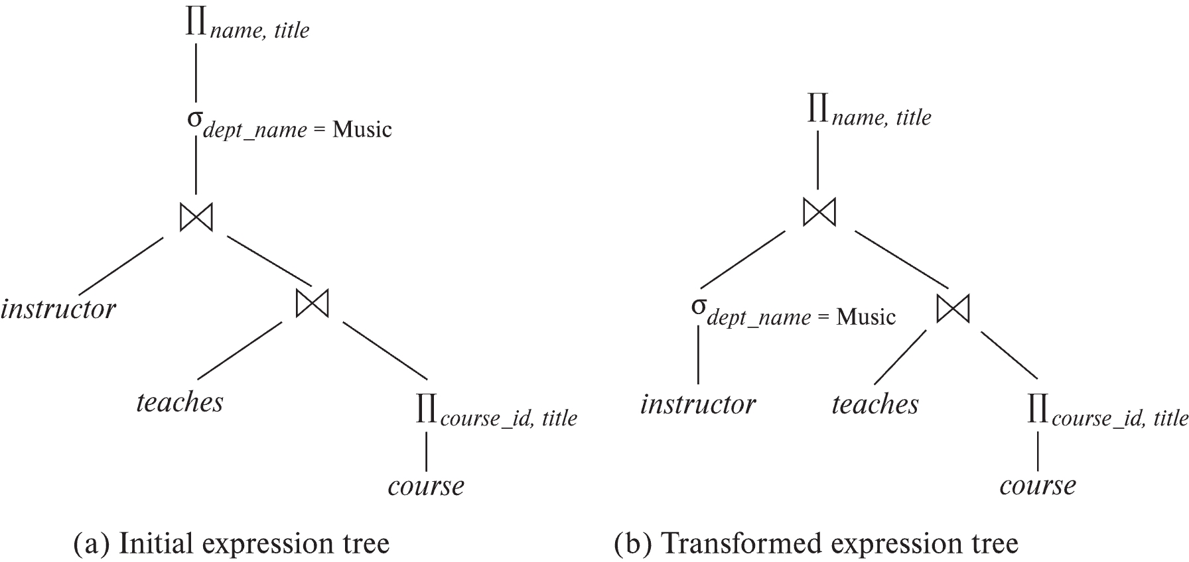
Introduction
Alternative ways of evaluating a given query
Equivalent expressions
Different algorithms for each operation

Slide 50
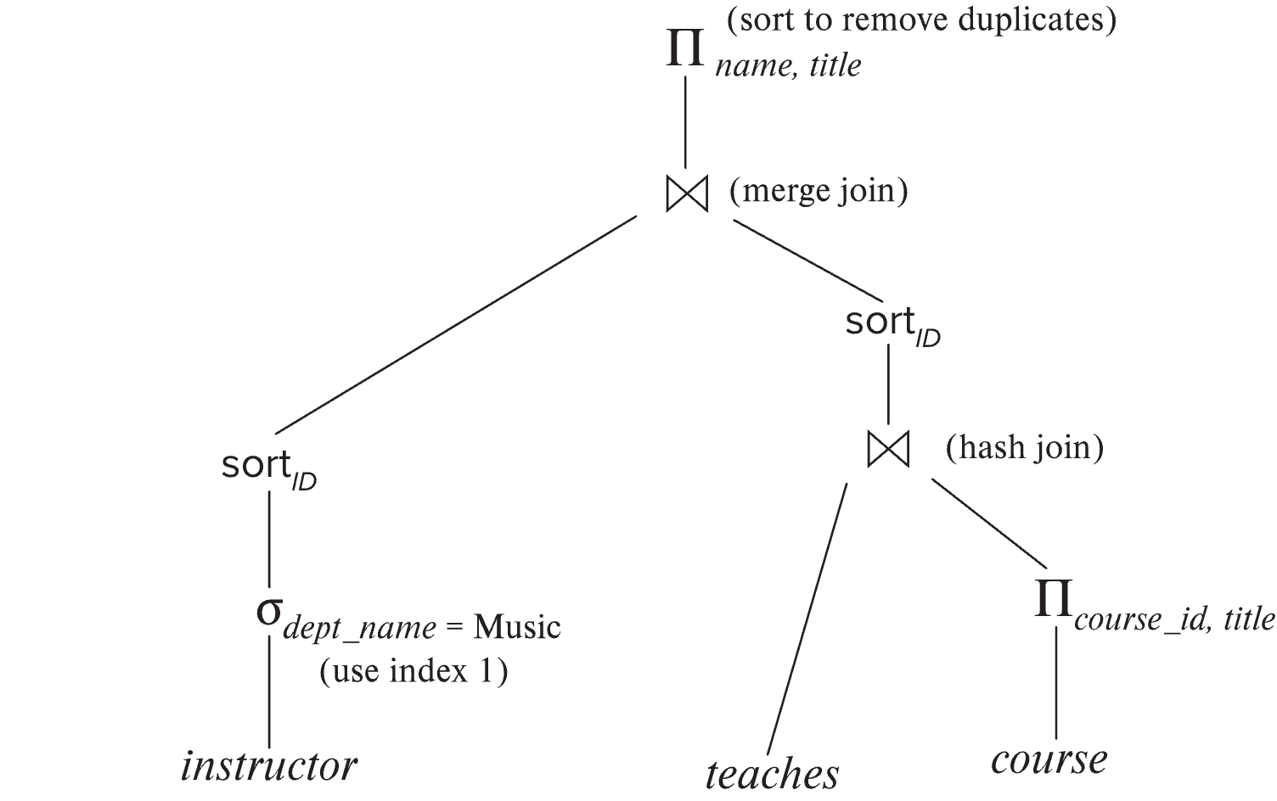
Introduction (Cont.)
An evaluation plan defines exactly what algorithm is used for each operation, and how the execution of the operations is coordinated.
Find out how to view query execution plans on your favorite database

Slide 51
Introduction (Cont.)
Cost difference between evaluation plans for a query can be enormous
E.g., seconds vs. days in some cases
Steps in cost-based query optimization
1. Generate logically equivalent expressions using equivalence rules
2. Annotate resultant expressions to get alternative query plans
3. Choose the cheapest plan based on estimated cost
Estimation of plan cost based on:
Statistical information about relations. Examples:
number of tuples, number of distinct values for an attribute
Statistics estimation for intermediate results
to compute cost of complex expressions
Cost formulae for algorithms, computed using statistics

Slide 52
Viewing Query Evaluation Plans
Most database support explain <query>
Displays plan chosen by query optimizer, along with cost estimates
Some syntax variations between databases
Oracle: explain plan for <query> followed by select * from table (dbms_xplan.display)
SQL Server: set showplan_text on
Some databases (e.g. PostgreSQL) support explain analyse <query>
Shows actual runtime statistics found by running the query, in addition to showing the plan
Some databases (e.g. PostgreSQL) show cost as f..l
f is the cost of delivering first tuple and l is cost of delivering all results

Slide 53
Generating Equivalent Expressions

Slide 54
Transformation of Relational Expressions
Two relational algebra expressions are said to be equivalent if the two expressions generate the same set of tuples on every legal database instance
Note: order of tuples is irrelevant
we don’t care if they generate different results on databases that violate integrity constraints
In SQL, inputs and outputs are multisets of tuples
Two expressions in the multiset version of the relational algebra are said to be equivalent if the two expressions generate the same multiset of tuples on every legal database instance.
An equivalence rule says that expressions of two forms are equivalent
Can replace expression of first form by second, or vice versa

Slide 55
Equivalence Rules
1. Conjunctive selection operations can be deconstructed into a sequence of individual selections. σ_{θ1 ∧ θ2} (E) ≡ σ_{θ1} (σ_{θ2} (E))
2. Selection operations are commutative. σ_{θ1}(σ_{θ2}(E)) ≡ σ_{θ2} (σ_{θ1}(E))
3. Only the last in a sequence of projection operations is needed, the others can be omitted. ∏ _{L1}(∏ _{L2}(…(∏ _{Ln}(E))…)) ≡ ∏ _{L1}(E) where L₁ ⊆ L₂ … ⊆ L_{n}
4. Selections can be combined with Cartesian products and theta joins.
σ_{θ} (E₁ x E₂) ≡ E₁ ⨝ _{θ} E₂
σ _{θ1} (E₁ ⨝_{θ2} E₂) ≡ E₁ ⨝ _{θ1∧θ2} E₂

Slide 56
Equivalence Rules (Cont.)
5. Theta-join operations (and natural joins) are commutative. E₁ ⨝ E₂ ≡ E₂ ⨝ E₁
6. (a) Natural join operations are associative:
(E₁ ⨝ E₂) ⨝ E₃ ≡ E₁ ⨝ (E₂ ⨝ E₃) (b) Theta joins are associative in the following manner: (E₁ ⨝ _{θ1} E₂) ⨝ _{θ2 ∧ θ3} E₃ ≡ E₁ ⨝_{θ1 ∧ θ3} (E₂ ⨝ _{θ2} E₃) where θ₂ involves attributes from only E₂ and E₃.

Slide 57
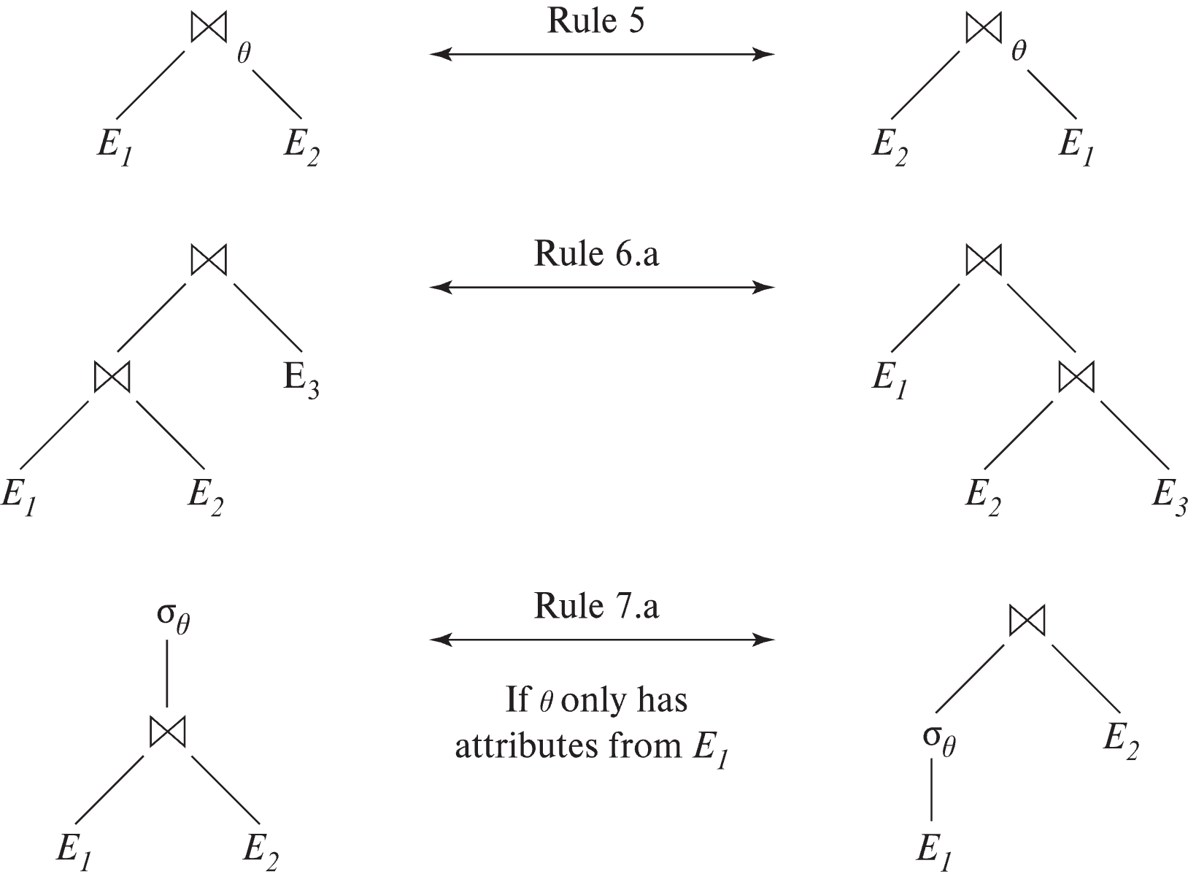
Pictorial Depiction of Equivalence Rules

Slide 58
Equivalence Rules (Cont.)
7. The selection operation distributes over the theta join operation under the following two conditions: (a) When all the attributes in θ₀ involve only the attributes of one of the expressions (E₁) being joined. σ_{θ0} (E₁ ⨝_{θ} E₂) ≡ (σ_{θ0}(E₁)) ⨝_{θ} E₂
(b) When θ₁ involves only the attributes of E₁ and θ₂ involves only the attributes of E₂.
σ_{θ1 ∧ θ2} (E₁ ⨝_{θ} E₂) ≡ (σ_{θ1}(E₁)) ⨝_{θ} (σ_{θ2}(E₂))

Slide 59
Equivalence Rules (Cont.)
8. The projection operation distributes over the theta join operation as follows:
(a) if θ involves only attributes from L₁ ∪ L₂: ∏ _{L1 ∪ L2}(E₁ ⨝_{θ} E₂) ≡ ∏ _{L1}(E₁) ⨝_{θ} ∏ _{L2}(E₂)
(b) In general, consider a join E₁ ⨝_{θ} E₂.
Let L₁ and L₂ be sets of attributes from E₁ and E₂, respectively.
Let L₃ be attributes of E₁ that are involved in join condition θ, but are not in L₁ ∪ L₂, and
let L₄ be attributes of E₂ that are involved in join condition θ, but are not in L₁ ∪ L₂. ∏ _{L1 ∪ L2}(E₁ ⨝_{θ} E₂) ≡ ∏ _{L1 ∪ L2}(∏ _{L1 ∪ L3}(E₁) ⨝_{θ} ∏ _{L2 ∪ L4}(E₂))
Similar equivalences hold for outerjoin operations: ⟕, ⟖, and ⟗

Slide 60
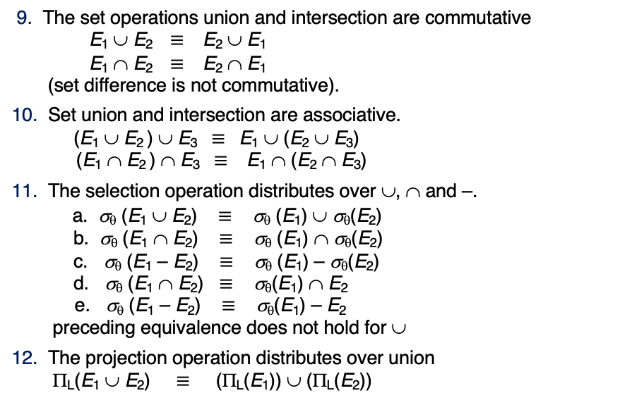
Equivalence Rules (Cont.)
9. The set operations union and intersection are commutative E₁ ∪ E₂ ≡ E₂ ∪ E₁ E₁ ∩ E₂ ≡ E₂ ∩ E₁ (set difference is not commutative).
10. Set union and intersection are associative. (E₁ ∪ E₂ ) ∪ E₃ ≡ E₁ ∪ (E₂ ∪ E₃) (E₁ ∩ E₂ ) ∩ E₃ ≡ E₁ ∩ (E₂ ∩ E₃)
11. The selection operation distributes over ∪, ∩ and –. a. σ_{θ} (E₁ ∪ E₂) ≡ σ_{θ} (E₁) ∪ σ_{θ}(E₂) b. σ_{θ} (E₁ ∩ E₂) ≡ σ_{θ} (E₁) ∩ σ_{θ}(E₂) c. σ_{θ} (E₁ – E₂) ≡ σ_{θ} (E₁) – σ_{θ}(E₂) d. σ_{θ} (E₁ ∩ E₂) ≡ σ_{θ}(E₁) ∩ E₂ e. σ_{θ} (E₁ – E₂) ≡ σ_{θ}(E₁) – E₂ preceding equivalence does not hold for ∪
12. The projection operation distributes over union Π_{L}(E₁ ∪ E₂) ≡ (Π_{L}(E₁)) ∪ (Π_{L}(E₂))

Slide 61
Equivalence Rules (Cont.)
13. Selection distributes over aggregation as below σ_{θ}(_{G}𝛾_{A}(E)) ≡ _{G}𝛾_{A}(σ_{θ}(E)) provided θ only involves attributes in G
14. a. Full outerjoin is commutative: E₁ ⟗ E₂ ≡ E₂ ⟗ E₁ b. Left and right outerjoin are not commutative, but: E₁ ⟕ E₂ ≡ E₂ ⟖ E₁
15. Selection distributes over left and right outerjoins as below, provided θ₁
only involves attributes of E₁ a. σ_{θ1} (E₁ ⟕_{θ} E₂) ≡ (σ_{θ1} (E₁)) ⟕_{θ} E₂ b. σ_{θ1} (E₁ ⟖_{θ} E₂) ≡ E₂ ⟕_{θ} (σ_{θ1} (E₁))
16. Outerjoins can be replaced by inner joins under some conditions
a. σ_{θ1} (E₁ ⟕_{θ} E₂) ≡ σ_{θ1} (E₁ ⨝_{θ} E₂) b. σ_{θ1} (E₁ ⟖_{θ} E₁) ≡ σ_{θ1} (E₁ ⨝_{θ} E₂) provided θ₁ is null rejecting on E₂

Slide 62
Equivalence Rules (Cont.)
Note that several equivalences that hold for joins do not hold for outerjoins
σ_{year=2017}(instructor ⟕ teaches) ≢ σ_{year=2017}(instructor ⨝ teaches)
Outerjoins are not associative (r ⟕ s) ⟕ t ≢ r ⟕ (s ⟕ t)
e.g. with r(A,B) = {(1,1), s(B,C) = { (1,1)}, t(A,C) = { }
Notes:
How about (r ⟕ s) ⟕ t vs (r ⟕ t) ⟕ s assuming r has common attributes with s and t? Hint: consider 2 cases where s and t have common attributes and those where they have no common attribute

Slide 63
Transformation Example: Pushing Selections
Query: Find the names of all instructors in the Music department, along with the titles of the courses that they teach
Π_{name, title}(σ_{dept_name= ‘Music’} (instructor ⨝ (teaches ⨝ Π_{course_id, title} (course))))
Transformation using rule 7a.
Π_{name, title}((σ_{dept_name= ‘Music’}(instructor)) ⨝ (teaches ⨝ Π_{course_id, title} (course)))
Performing the selection as early as possible reduces the size of the relation to be joined.

Slide 64
Example with Multiple Transformations
Query: Find the names of all instructors in the Music department who have taught a course in 2017, along with the titles of the courses that they taught
Π_{name, title}(σ_{dept_name= "Music”∧year = 2017} (instructor ⨝ (teaches ⨝ Π_{course_id, title} (course))))
Transformation using join associatively (Rule 6a):
Π_{name, title}(σ_{dept_name= “Music”∧year = 2017} ((instructor ⨝ teaches) ⨝ Π_{course_id, title} (course)))
Second form provides an opportunity to apply the “perform selections early” rule, resulting in the subexpression
σ_{dept_name = “Music”} (instructor) ⨝ σ _{year = 2017} (teaches)

Slide 65
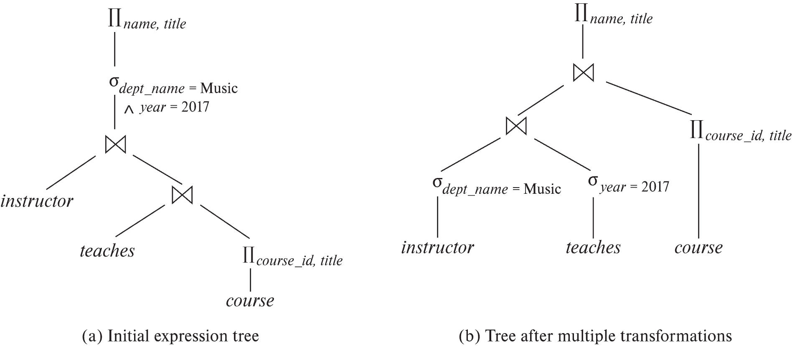
Multiple Transformations (Cont.)

Slide 66
Transformation Example: Pushing Projections
Consider: Π_{name, title}(σ_{dept_name= “Music”} (instructor) ⨝ teaches) ⨝ Π_{course_id, title} (course))))
When we compute
(σ_{dept_name = “Music”} (instructor ⨝ teaches)
we obtain a relation whose schema is: (ID, name, dept_name, salary, course_id, sec_id, semester, year)
Push projections using equivalence rules 8a and 8b; eliminate unneeded attributes from intermediate results to get: Π_{name, title}(Π_{name, course_id} ( σ_{dept_name= “Music”} (instructor) ⨝ teaches)) ⨝ Π_{course_id, title} (course))))
Performing the projection as early as possible reduces the size of the relation to be joined.

Slide 67
Join Ordering Example
For all relations r_{1,} r_{2,} and r₃,
(r₁ ⨝ r₂) ⨝ r₃ = r₁ ⨝ (r₂ ⨝ r₃ )
(Join Associativity) ⨝
If r₂ ⨝ r₃ is quite large and r₁ ⨝ r₂ is small, we choose
(r₁ ⨝ r₂) ⨝ r₃
so that we compute and store a smaller temporary relation.

Slide 68
Join Ordering Example (Cont.)
Consider the expression
Π_{name, title}(σ_{dept_name= “Music”} (instructor) ⨝ teaches) ⨝ Π_{course_id, title} (course))))
Could compute teaches ⨝ Π_{course_id, title} (course) first, and join result with σ_{dept_name= “Music”} (instructor) but the result of the first join is likely to be a large relation.
Only a small fraction of the university’s instructors are likely to be from the Music department
it is better to compute
σ_{dept_name= “Music”} (instructor) ⨝ teaches
first.

Slide 69
Enumeration of Equivalent Expressions
Query optimizers use equivalence rules to systematically generate expressions equivalent to the given expression
Can generate all equivalent expressions as follows:
Repeat
apply all applicable equivalence rules on every subexpression of every equivalent expression found so far
add newly generated expressions to the set of equivalent expressions
Until no new equivalent expressions are generated above
The above approach is very expensive in space and time
Two approaches
Optimized plan generation based on transformation rules
Special case approach for queries with only selections, projections and joins

Slide 70
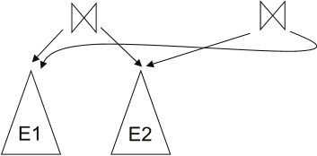
Implementing Transformation Based Optimization
Space requirements reduced by sharing common sub-expressions:
when E1 is generated from E2 by an equivalence rule, usually only the top level of the two are different, subtrees below are the same and can be shared using pointers
E.g., when applying join commutativity
Same sub-expression may get generated multiple times
Detect duplicate sub-expressions and share one copy
Time requirements are reduced by not generating all expressions
Dynamic programming
We will study only the special case of dynamic programming for join order optimization

Slide 71
Cost Estimation
Cost of each operator computer as described in Chapter 15
Need statistics of input relations
E.g., number of tuples, sizes of tuples
Inputs can be results of sub-expressions
Need to estimate statistics of expression results
To do so, we require additional statistics
E.g., number of distinct values for an attribute
More on cost estimation later

Slide 72
Choice of Evaluation Plans
Must consider the interaction of evaluation techniques when choosing evaluation plans
choosing the cheapest algorithm for each operation independently may not yield best overall algorithm. E.g.
merge-join may be costlier than hash-join, but may provide a sorted output which reduces the cost for an outer level aggregation.
nested-loop join may provide opportunity for pipelining
Practical query optimizers incorporate elements of the following two broad approaches:
1. Search all the plans and choose the best plan in a cost-based fashion.
2. Uses heuristics to choose a plan.

Slide 73
Cost-Based Optimization
Consider finding the best join-order for r₁ ⨝ r₂ ⨝ . . . ⨝ r_{n}.
There are (2(n – 1))!/(n – 1)! different join orders for above expression. With n = 7, the number is 665280, with n = 10, the number is greater than 176 billion!
No need to generate all the join orders. Using dynamic programming, the least-cost join order for any subset of {r₁, r₂, . . . r_{n}} is computed only once and stored for future use.

Slide 74
Statistics for Cost Estimation

Slide 75
Statistical Information for Cost Estimation
n_{r}: number of tuples in a relation r.
b_{r}: number of blocks containing tuples of r.
l_{r}: size of a tuple of r.
f_{r}: blocking factor of r — i.e., the number of tuples of r that fit into one block.
V(A, r): number of distinct values that appear in r for attribute A; same as the size of ∏_{A}(r).
If tuples of r are stored together physically in a file, then:

Slide 76
Histograms
Histogram on attribute age of relation person
Equi-width histograms
Equi-depth histograms break up range such that each range has (approximately) the same number of tuples
E.g. (4, 8, 14, 19)
Many databases also store n most-frequent values and their counts
Histogram is built on remaining values only

Slide 77
Histograms (cont.)
Histograms and other statistics usually computed based on a random sample
Statistics may be out of date
Some database require a analyze command to be executed to update statistics
Others automatically recompute statistics
e.g., when number of tuples in a relation changes by some percentage

Slide 78
Selection Size Estimation
σ_{A=v}(r)
n_{r} / V(A,r) : number of records that will satisfy the selection
Equality condition on a key attribute: size estimate = 1
σ_{A≤V}(r) (case of σ_{A ≥ V}(r) is symmetric)
Let c denote the estimated number of tuples satisfying the condition.
If min(A,r) and max(A,r) are available in catalog
c = 0 if v < min(A,r)
c =
If histograms available, can refine above estimate
In absence of statistical information c is assumed to be n_{r} / 2.

Slide 79
Data Management
Today
Load/save things quickly.
Find things quickly.
Query/Change Data
Database Systems: The Complete Book (2nd Edition) by Hector Garcia-Molina (Author), Jeffrey D. Ullman (Author), Jennifer Widom (Author)

Slide 80
NoSQL (3)
80 | COMS W4111_002_2024_1 - Lecture 10: Module II (3), NoSQL (3) © Donald F. Ferguson, 2024

Slide 81
Reminder
81 | COMS W4111_002_2024_1 - Lecture 10: Module II (3), NoSQL (3) © Donald F. Ferguson, 2024

Slide 82
Simplistic Classification (https://medium.com/swlh/4-types-of-nosql-databases-d88ad21f7d3b)
Relational is the foundational model.
We will see OLAP in a future lecture.
Continue Today
Begin Today

Slide 83
Graph Databases Neo4j
83 | COMS W4111_002_2024_1 - Lecture 10: Module II (3), NoSQL (3) © Donald F. Ferguson, 2024

Slide 84
Graph Database
Exactly what it sounds like
Two core types
Node
Edge (link)
Nodes and Edges have
Label(s) = “Kind”
Properties (free form)
Query is of the form
p1(n)-p2(e)-p3(m)
n, m are nodes; e is an edge
p1, p2, p3 are predicates on labels
N->R->M

Slide 85
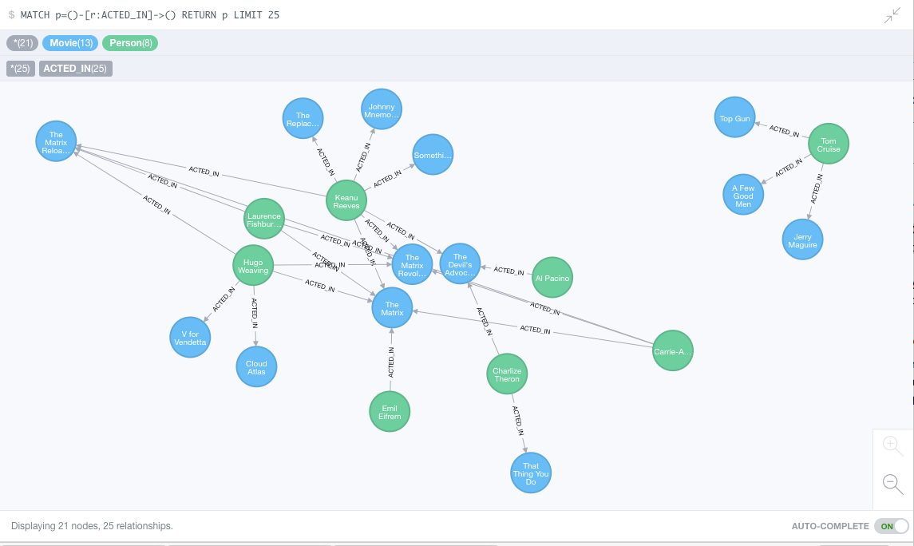
Neo4J Graph Query

Slide 86
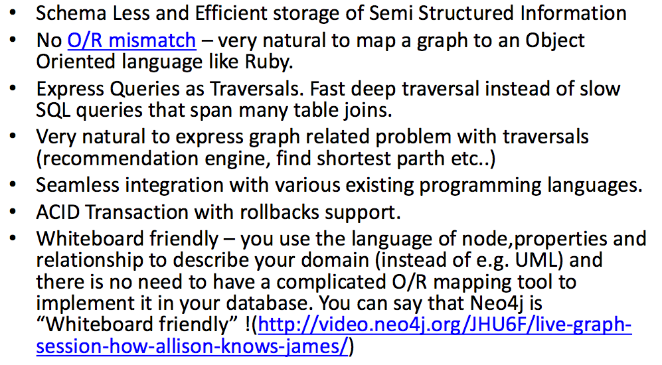
Why Graph Databases?

Slide 87
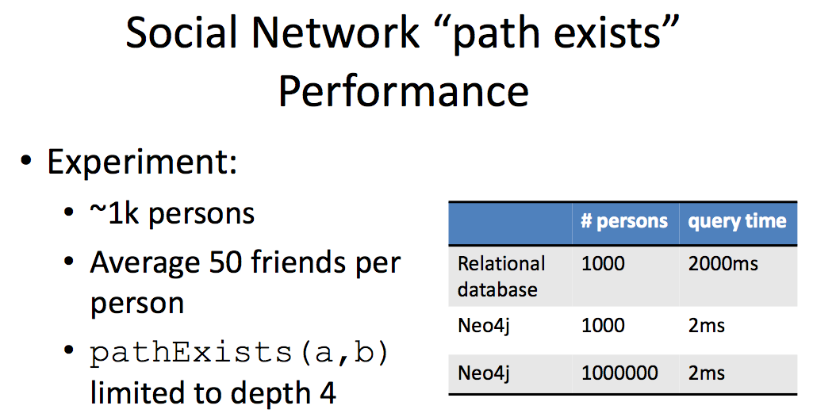
Graph databases are
Extremely fast for some queries and data models.
Implement a language that vastly simplifies writing queries.

Slide 88
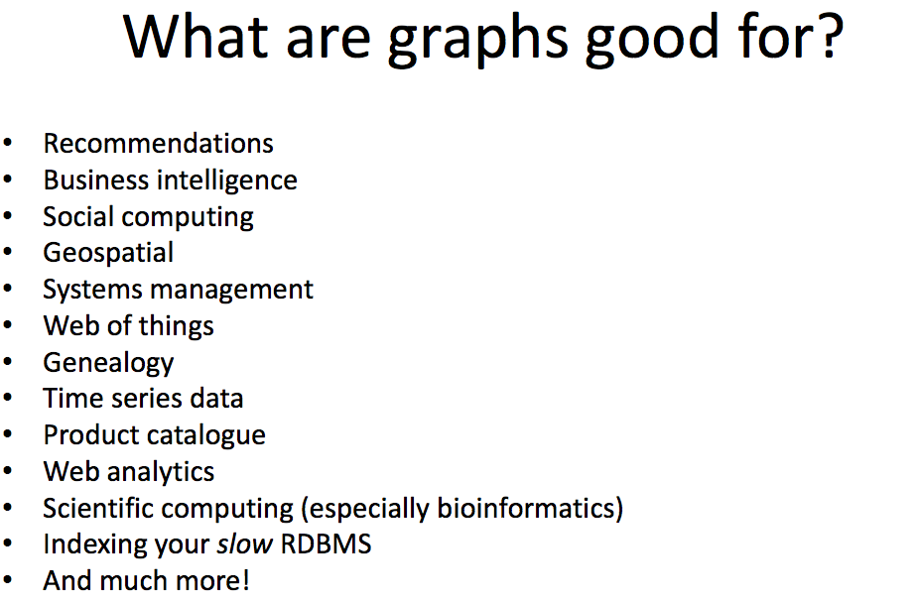

Slide 89
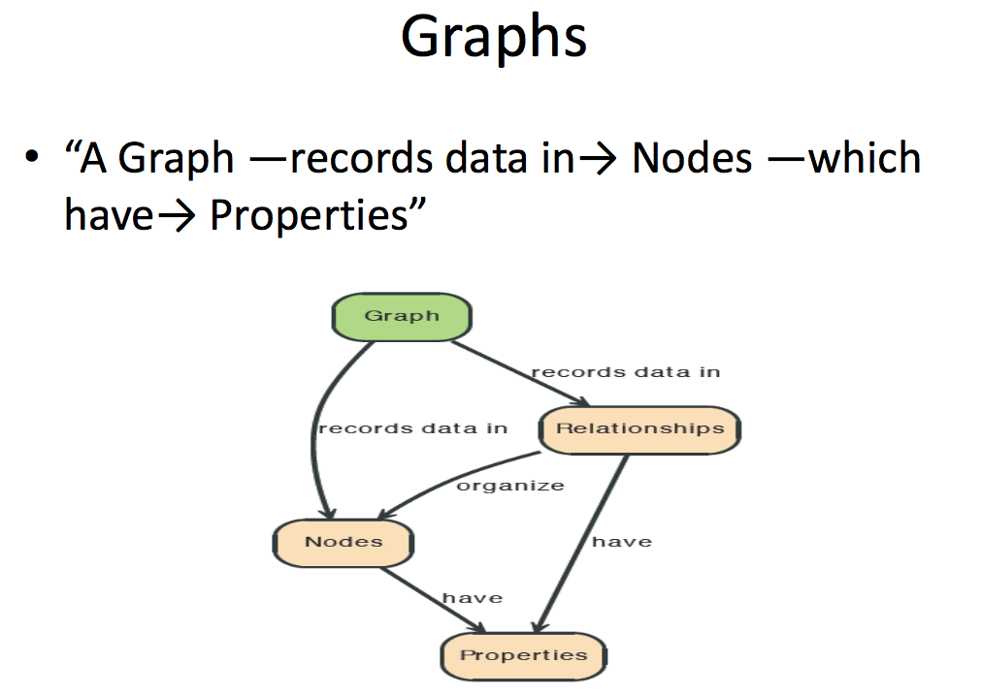

Slide 90
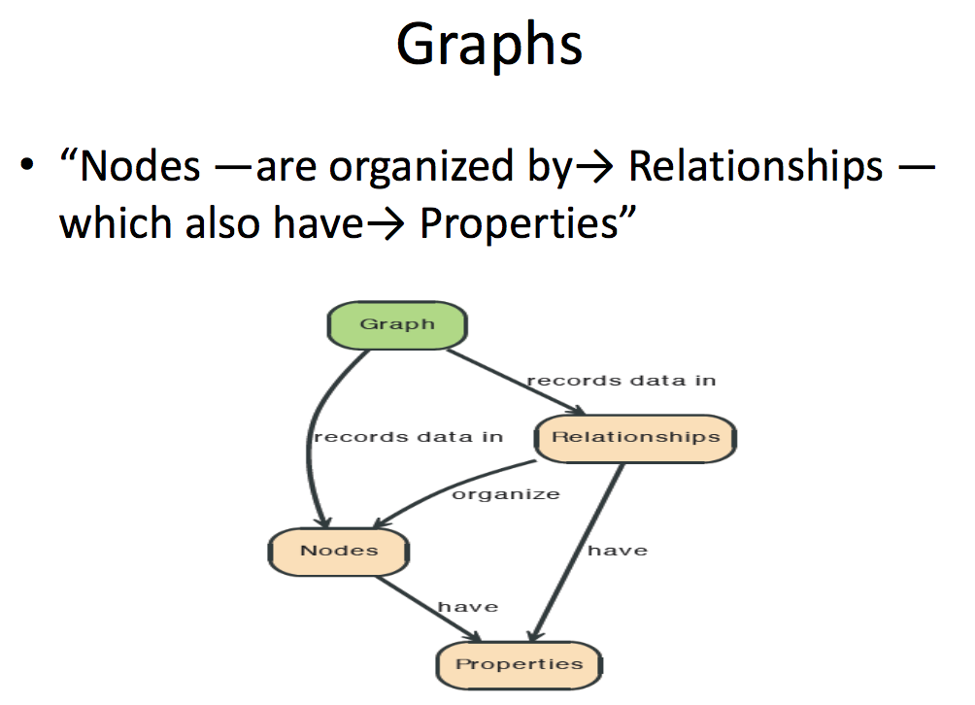

Slide 91
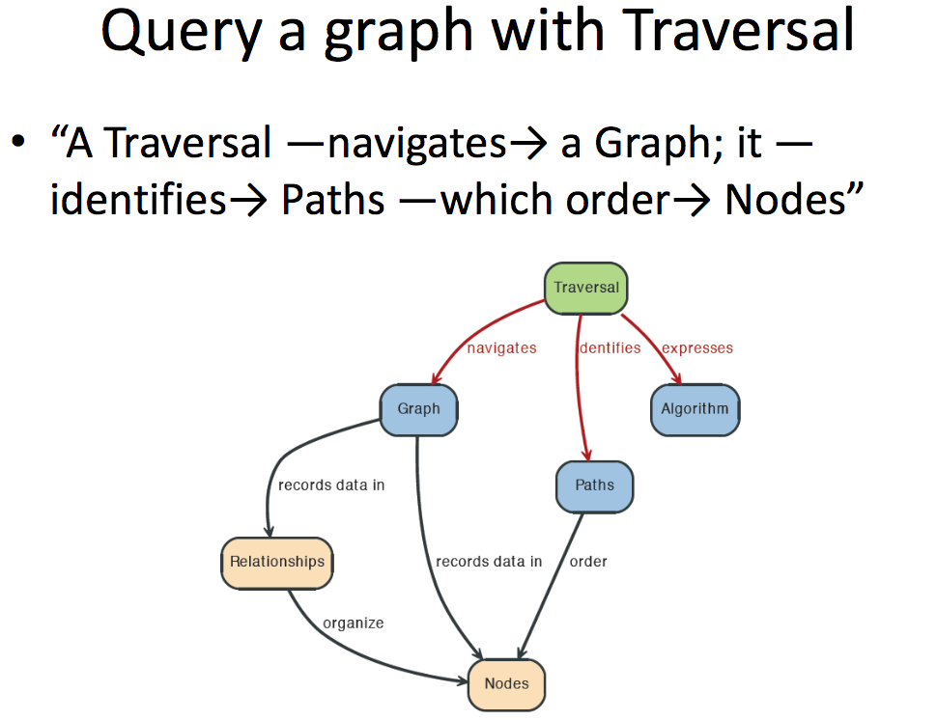

Slide 92
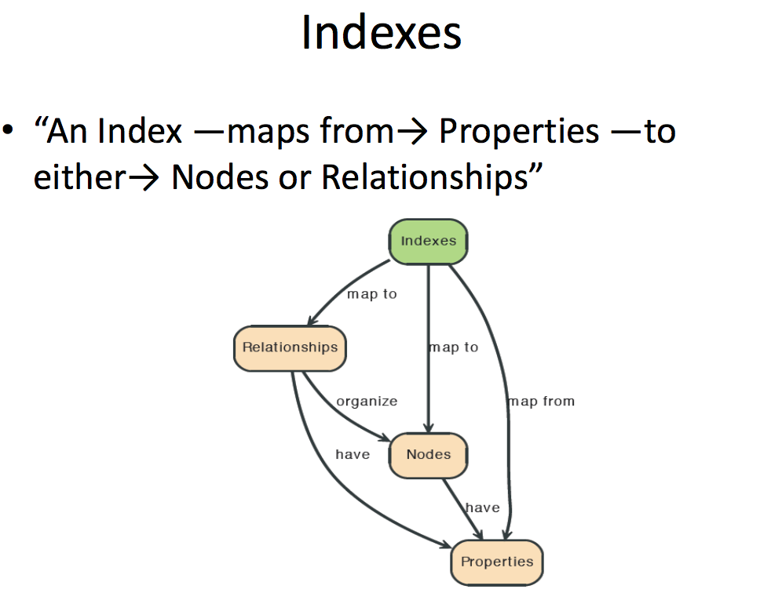

Slide 93
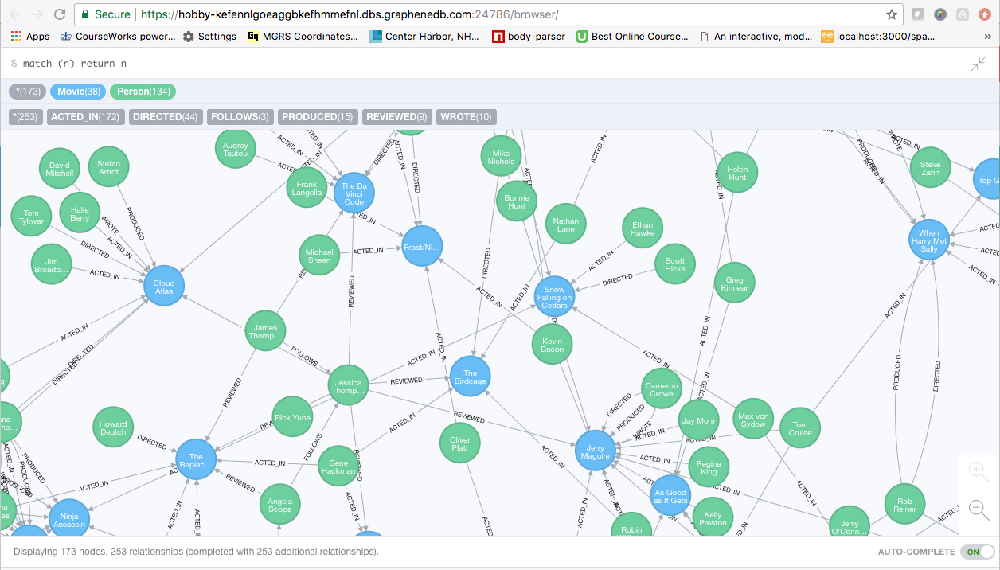
A Graph Database (Sample)

Slide 94
Neo4J Graph Query
Who acted in which movies?

Slide 95
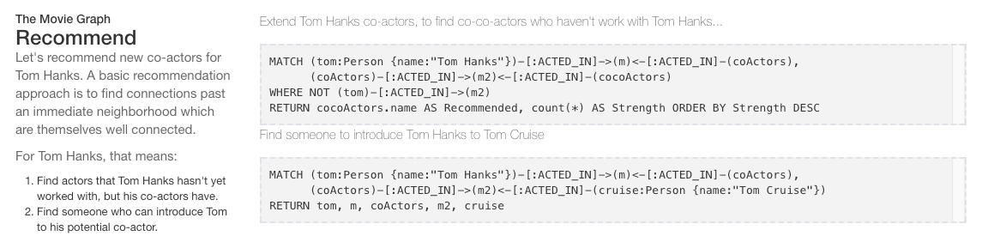
Big Deal. That is just a JOIN.
Yup. But that is simple.
Try writing the queries below in SQL.

Slide 96
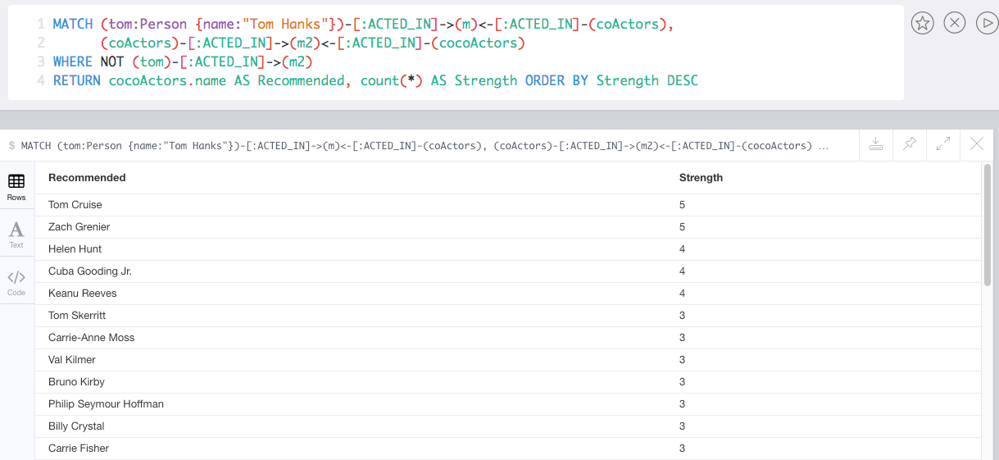
Recommend

Slide 97
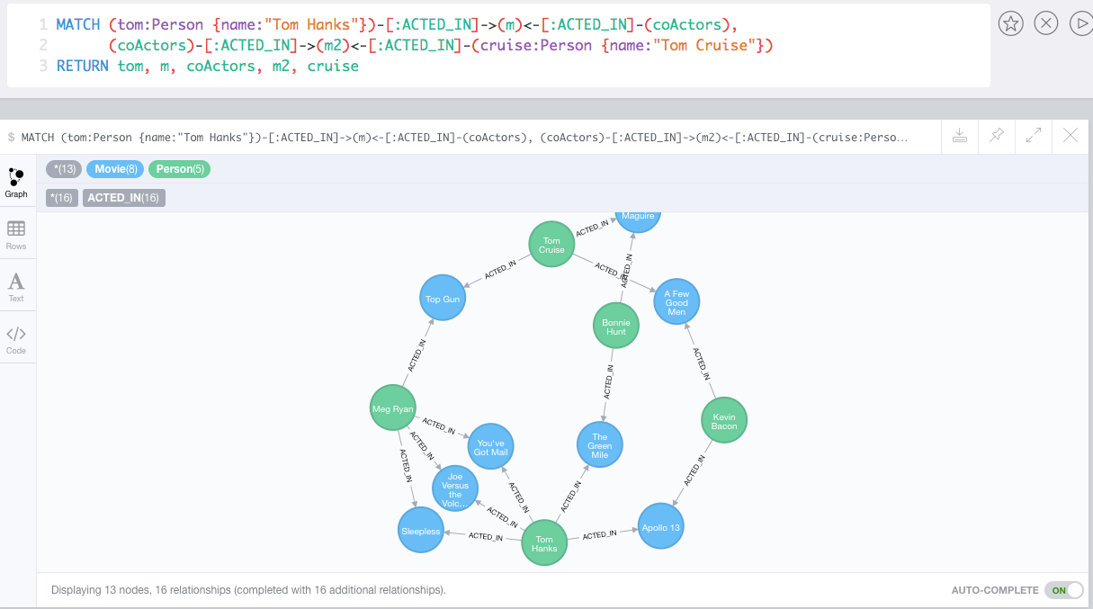
Which actors have worked with both Tom Hanks and
Tom Cruise?

Slide 98
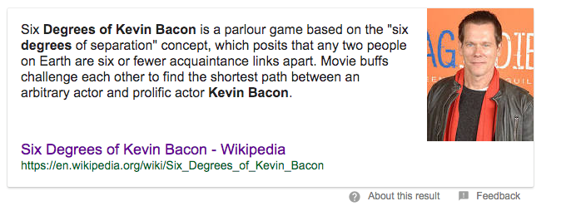
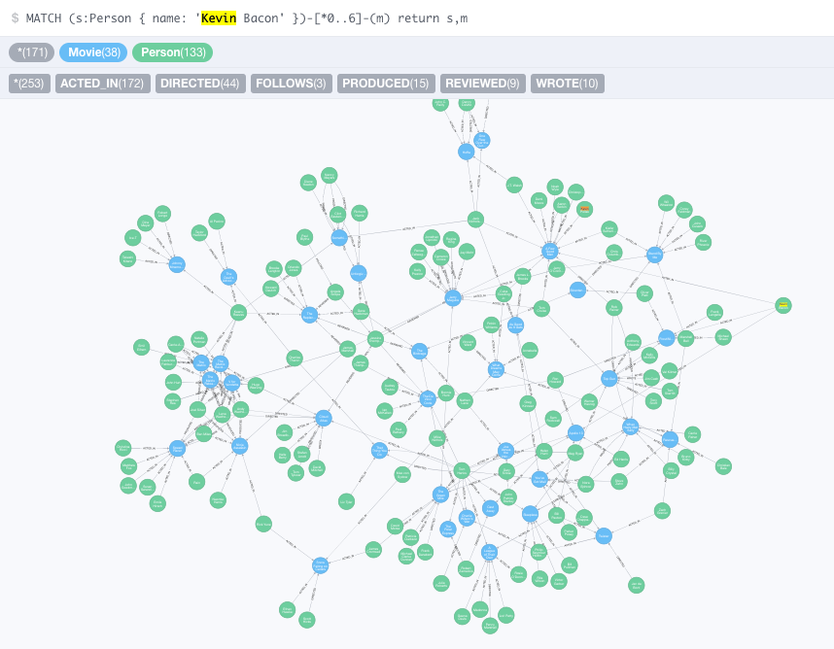


Slide 99
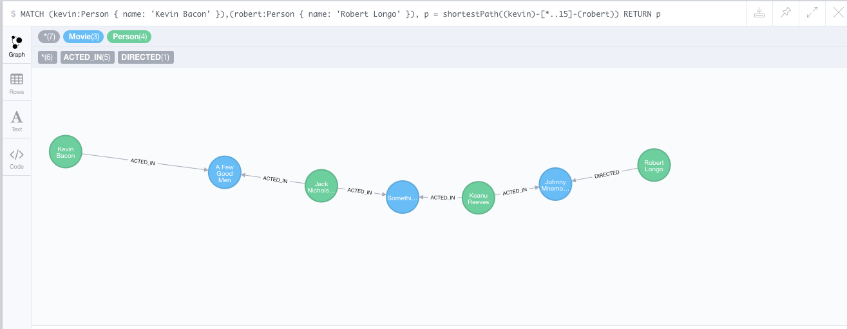
How do you get from Kevin Bacon to
Robert Longo?

Slide 100
Backup
100 | COMS W4111_002_2024_1 - Lecture 10: Module II (3), NoSQL (3) © Donald F. Ferguson, 2024

Slide 101
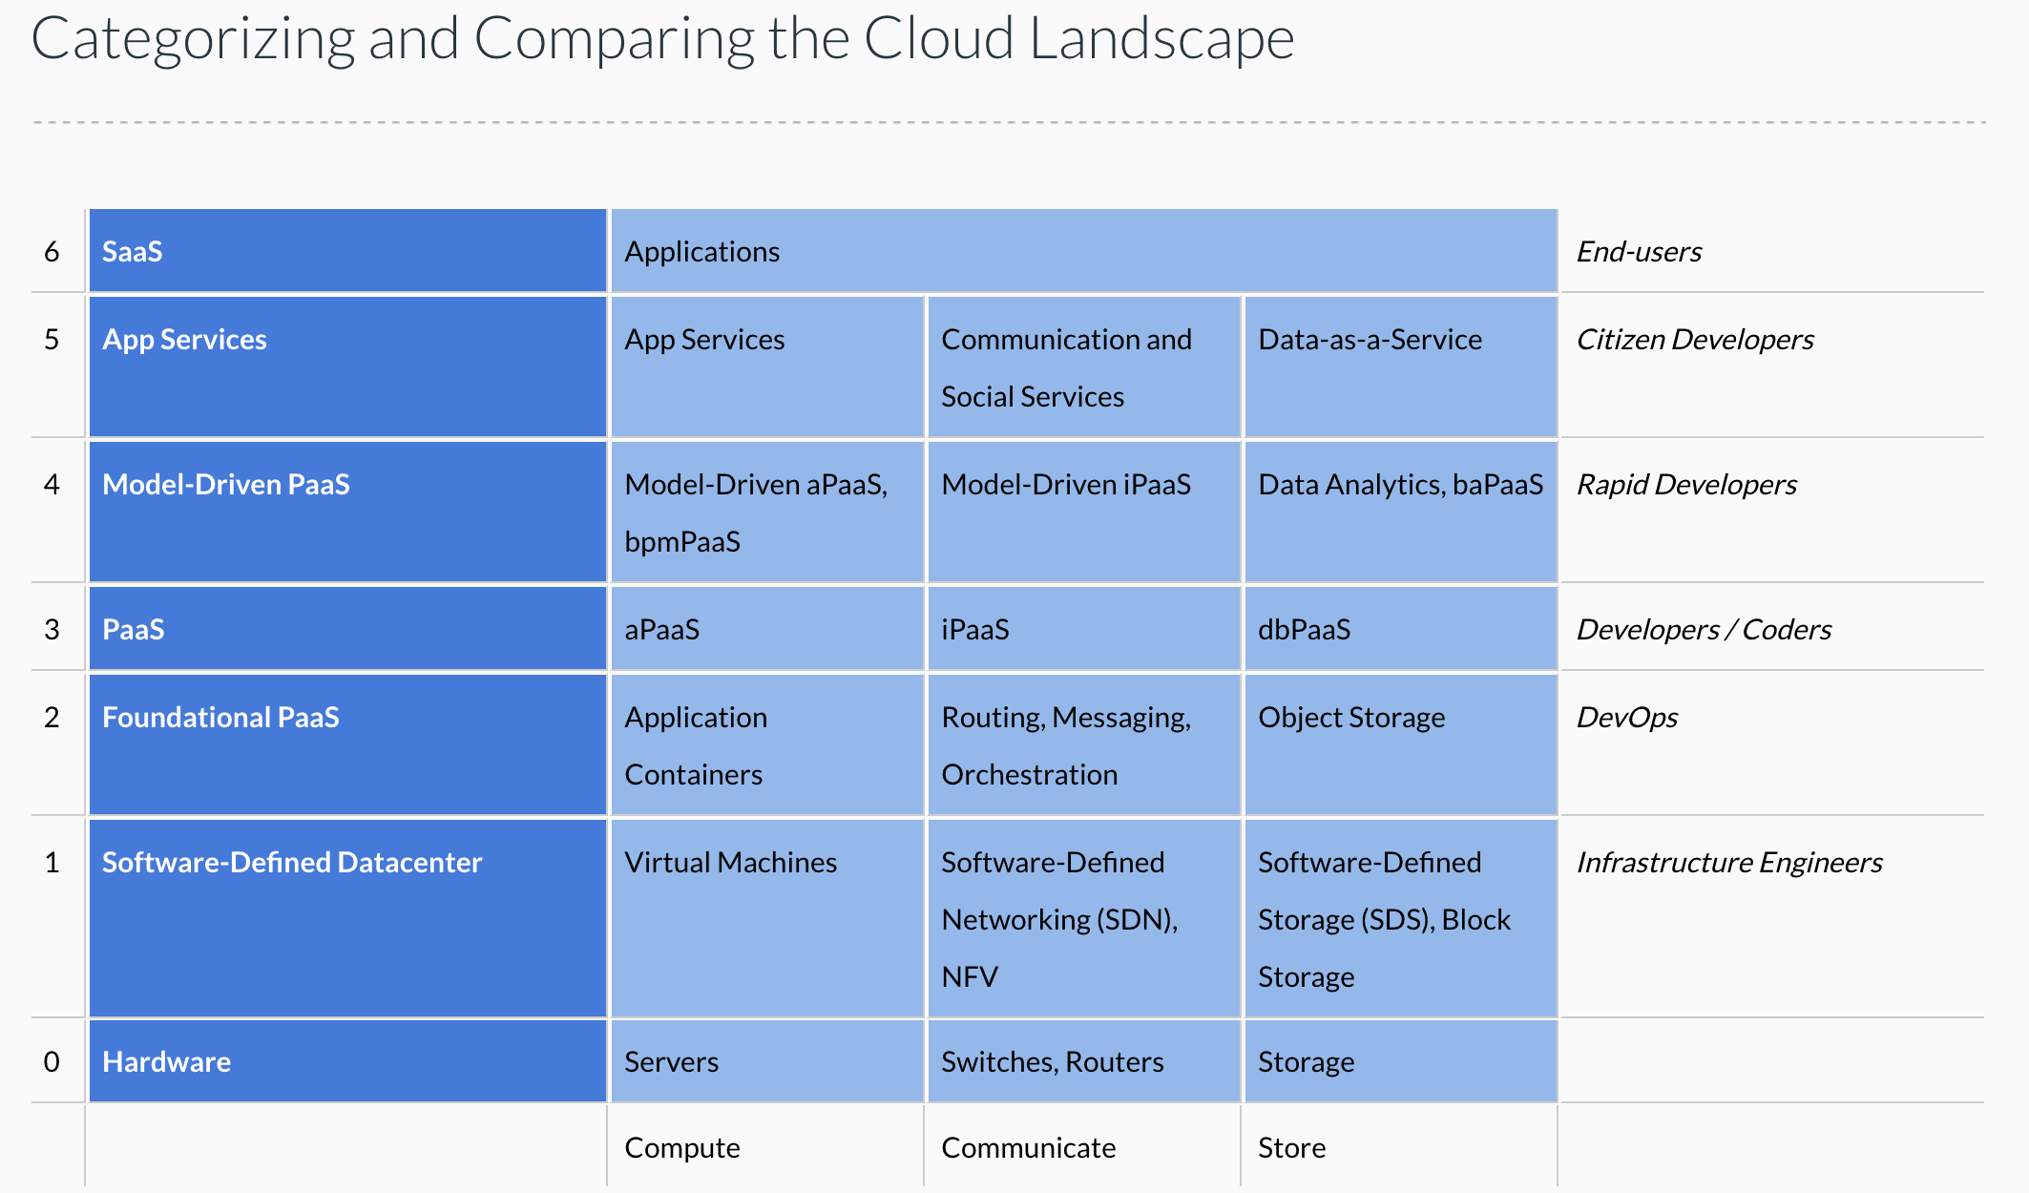
Cloud Concepts – One Perspective
http://www.theenterprisearchitect.eu/blog/2013/10/12/the-cloud-landscape-described-categorized-and-compared/

Slide 102
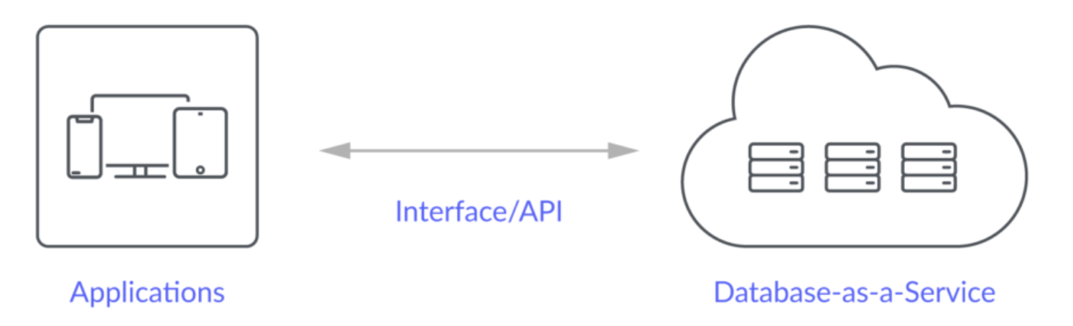
Database-as-a-Service
“A cloud database is a database that typically runs on a cloud computing platform and access to the database is provided as-a-service. There are two common deployment models: users can run databases on the cloud independently, using a virtual machine image, or they can purchase access to a database service, maintained by a cloud database provider. Of the databases available on the cloud, some are SQL-based and some use a NoSQL data model.
Database services take care of scalability and high availability of the database. Database services make the underlying software-stack transparent to the user.” (Wikipedia)

Slide 104
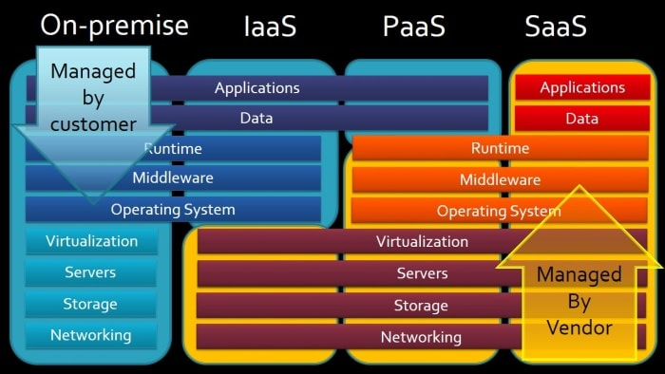
Cloud Computing Layers

